Slide 1
IMDb Movie Analysis
Data Analysis by: Shefalika Thapa

Slide 2
Problem Statement
The question of "What factors influence the success of a movie on IMDb?" could be one to look into since High IMDb ratings can be used to measure success in this case.
This issue has a big impact on filmmakers, directors, and financiers who want to know what makes a movie successful so they may make wise choices for their upcoming ventures.

Slide 3
PROJECT DESCRIPTION
In the dynamic world of the film industry, understanding the key determinants that contribute to the success of a movie is pivotal for stakeholders like movie producers, directors, and investors. This project aims to delve into the factors that influence a movie's success, as measured by high IMDb ratings. By analyzing a comprehensive dataset of IMDb movies, this investigation seeks to provide actionable insights to empower decision-making and enhance the prospects of future movie projects.
TECH STACK
Microsoft Excel 2019

Slide 4
APPROACH
Data Cleaning Steps:
Removed duplicate rows using Excel’s “Remove Duplicates” option
Removed unnecessary columns such as director_facebook_likes, plot_keywords,etc.
Deleted the missing values’ rows by using the filter data option on each column
Separated the genres by using “Text-to-column” option of the Excel.
File Link: https://docs.google.com/spreadsheets/d/164i2kElLgecebpvvqT8plJRyfKX4bKKu/edit?usp=sharing&ouid=111360395057791388166&rtpof=true&sd=true

Slide 5
DATA ANALYSIS PROCESS
Movie Genre Analysis: Analyze the distribution of movie genres and their impact on the IMDb score.
Task: Determine the most common genres of movies in the dataset. Then, for each genre, calculate descriptive statistics (mean, median, mode, range, variance, standard deviation) of the IMDb scores.
Functions used : COUNTIF, AVERAGE, MEDIAN, MODE.SNGL, MAX, MIN, VAR.P & STDEV.P

Slide 6
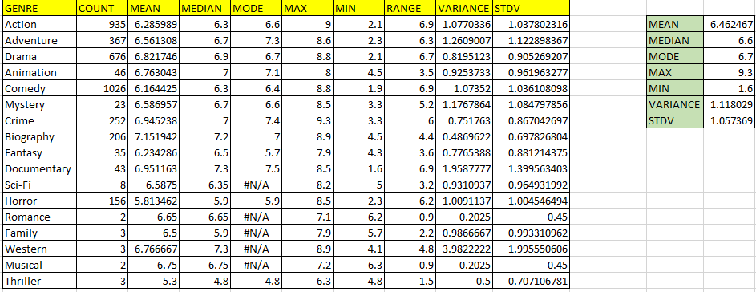

Slide 7
INSIGHTS
Most frequently occurring genre: Comedy (Count-1026)
Why comedy? People like to relax after work by enjoying comedy movies.
Least frequently occurring genre: Musical
Highest Average IMDb score: 7.15 (Biography)
Standard deviation is a statistical measure that quantifies the amount of variability or dispersion in a set of data points. It indicates how much individual data points in a dataset deviate from the mean (average) value. It ranges from 0.45 to 1.99.

Slide 8
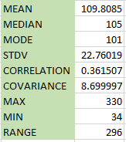
Movie Duration Analysis: Analyze the distribution of movie durations and its impact on the IMDb score.
Task: Analyze the distribution of movie durations and identify the relationship between movie duration and IMDb score.
DESCRIPTIVE STATISTICS OF MOVIE DURATION

Slide 9
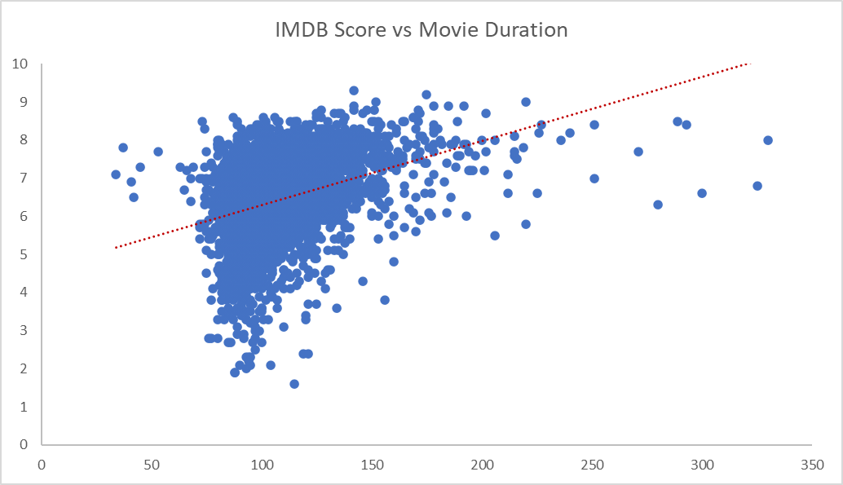

Slide 10
INSIGHTS
Average duration of the movies is : 109.80 minutes ~ 1h 50 min
Standard deviation is 22.7 which is really high and shows that the data points are widely dispersed.
A correlation coefficient of 0.36 suggests that there is some positive association between movie duration and IMDb scores, but it's not a very strong relationship. This means that, on average, movies with longer durations tend to have slightly higher IMDb scores, but the relationship is not strong enough to predict IMDb scores solely based on movie duration. Other factors could also be influencing the IMDb scores.
Covariance is a statistical measure that indicates how two variables change together. In this case, a covariance of 8.69 between movie duration and IMDb scores suggests a positive relationship between the two variables, indicating that they tend to increase or decrease together.
Trendline shows a fairly positive linear relationship between the two variables.

Slide 11
OUTLIER DETECTION
It can be seen in the scatter plot that there are many outliers. The same can be confirmed using MAX and MIN functions.
MAX movie duration is 330 min which is approximately 5 h 30 min. This is not possible as it deviates from the normal movie duration range.
Similarly, MIN movie duration is 34 min. This could be an outlier or there can be a possibility that this is a short movie.
Accordingly, after discussing with the team, we can take a call regarding these data points.

Slide 12
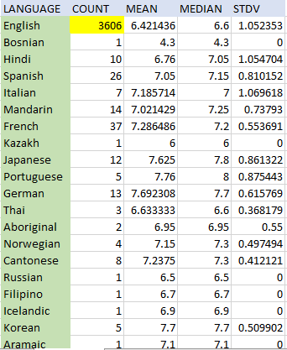
Language Analysis: Examine the distribution of movies based on their language.
Task: Determine the most common languages used in movies and analyze their impact on the IMDB score using descriptive statistics.

Slide 13
INSIGHTS
Majority of the movies are made in English language (Count-3606) and the average IMDb score is 6.42, median is 6.6 and standard deviation is 1.05. A standard deviation of 1.05 for IMDb scores of English language movies indicates that the IMDb scores for this particular group of movies have relatively low variability or dispersion around the mean (average) IMDb score.
Other language movies such as Spanish, Dutch, Persian,Telugu,etc. have better IMDb scores than English. This could be possible due to many reasons such as people’s interest in foreign language movies and stories or probably they are less in number, hence the scores remain less impacted by the averaging-out process.

Slide 14
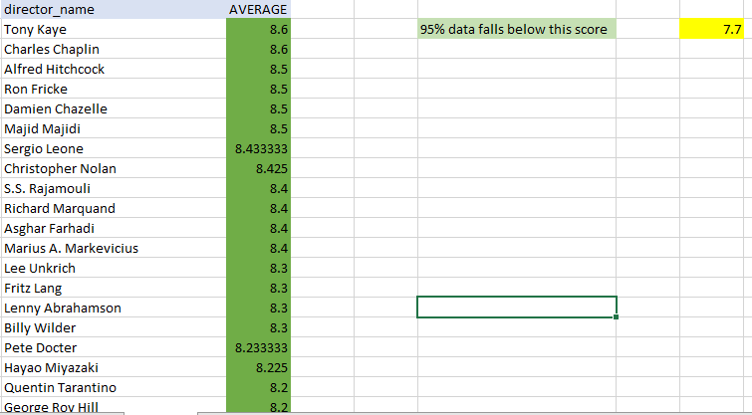
Director Analysis: Influence of directors on movie ratings.
Task: Identify the top directors based on their average IMDb score and analyze their contribution to the success of movies using percentile calculations.

Slide 15
INSIGHTS
Tony Kaye and Charles Chaplin movies have the highest average IMDb scores of 8.6 each.
Using the PERCENTILE.INC formula, it can be calculated that 7.7 is the score below which 95% of the data points fall.
Overall average IMDb score is 6.46, hence it can be observed that directors with high scoring movies such as Tony Kaye, Alfred Hitchcock, S.S. Rajamouli,etc. have IMDb scores well above the average score.
It states that the directors have positive influence over the IMDb ratings of the movies.

Slide 16
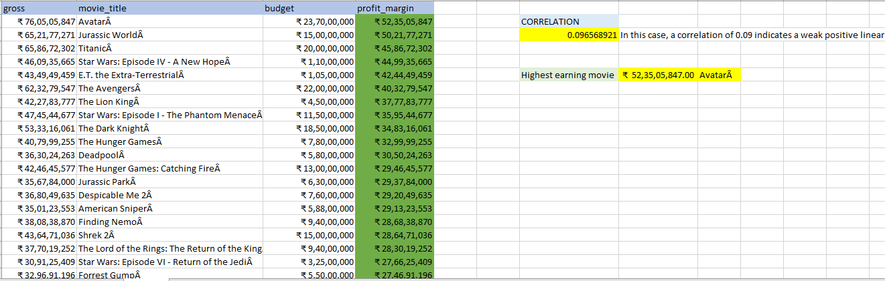
Budget Analysis: Explore the relationship between movie budgets and their financial success.
Task: Analyze the correlation between movie budgets and gross earnings, and identify the movies with the highest profit margin.

Slide 17
INSIGHTS
The correlation score between the movie budget and gross earnings is : 0.096
In this case, a correlation of 0.09 indicates a weak positive linear relationship between the two variables being analyzed. This means that as one variable increases, the other tends to increase, but the relationship is not very strong.
It suggests that it could be possible that higher the budget, the more popular the movie will be but it might not always be true. Other factors such as actors, directors, campaigning, advertisement, plot, acting,etc. also influence a movie’s success rate.
Highest earning movies are in the order: Avatar, Jurassic World, Titanic, Star Wars and E.T.
Used INDEX-MATCH and MAX formulas to display the movie with highest profit margin.

Slide 18
RESULT
Through this project case study, I learned to apply advanced Excel formulas and functions. Options such as “Remove Duplicates”, “Sort” and “Conditional Formatting” helped in analysing various aspects of the dataset. I also gained more clarity on statistical concepts such as mean, median,mode, standard deviation,correlation,etc. This helped me gauge deep into the patterns and trends of the data.
THANK YOU!

